Slide 1




From 0 to Conversational AI with Microsoft Azure
Riccardo Cappello
Senior ICS Consultant @ Insight
Microsoft Azure MVP
Intel Software Innovator

Slide 2
What is Conversational AI
Notes:
r

Slide 3
Conversational AI
“Conversational AI refers to the use of messaging apps, speech-based assistants and chatbots to automate communication and create personalized customer experiences at scale”
“A chatbot is a computer software program designed to simulate human conversation via text, audio messages, or images”
Notes:
r

Slide 4


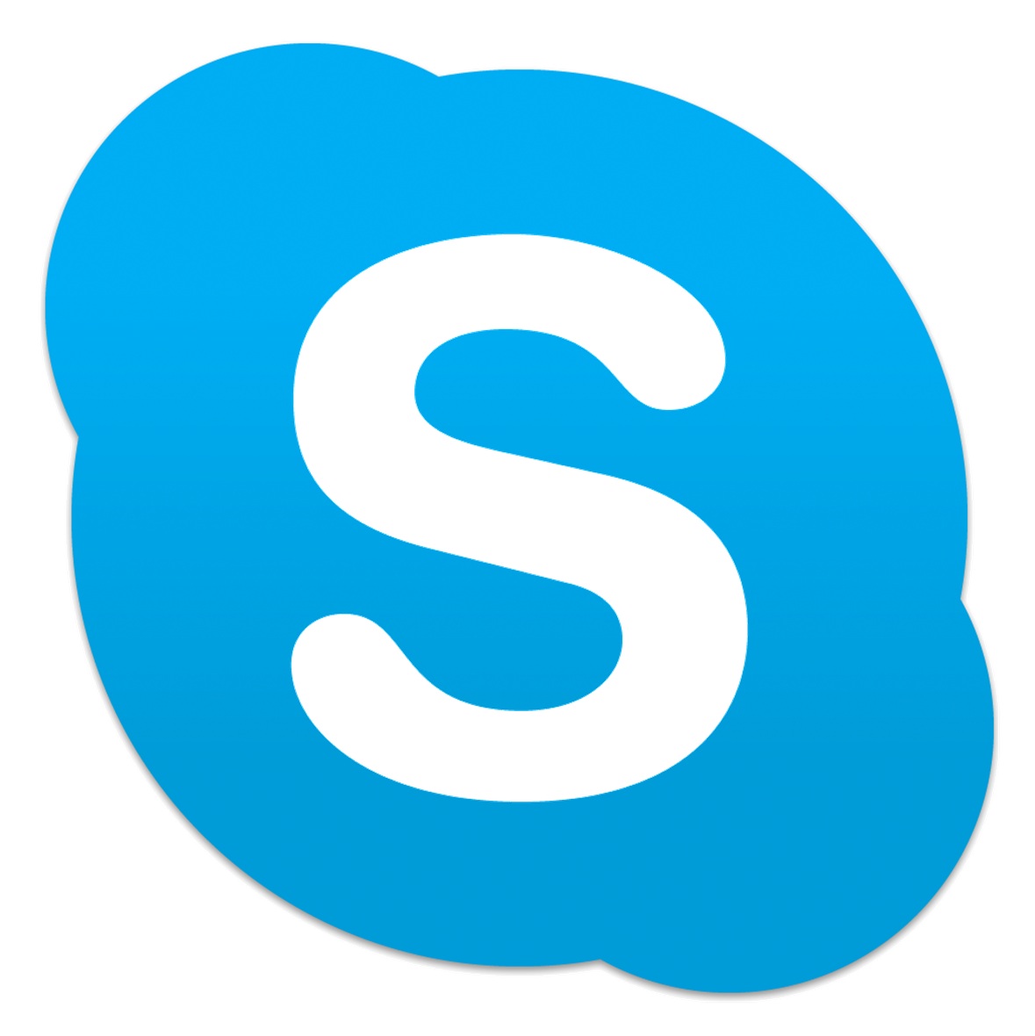

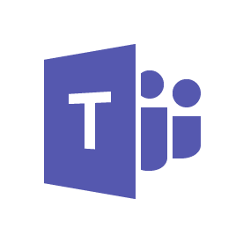
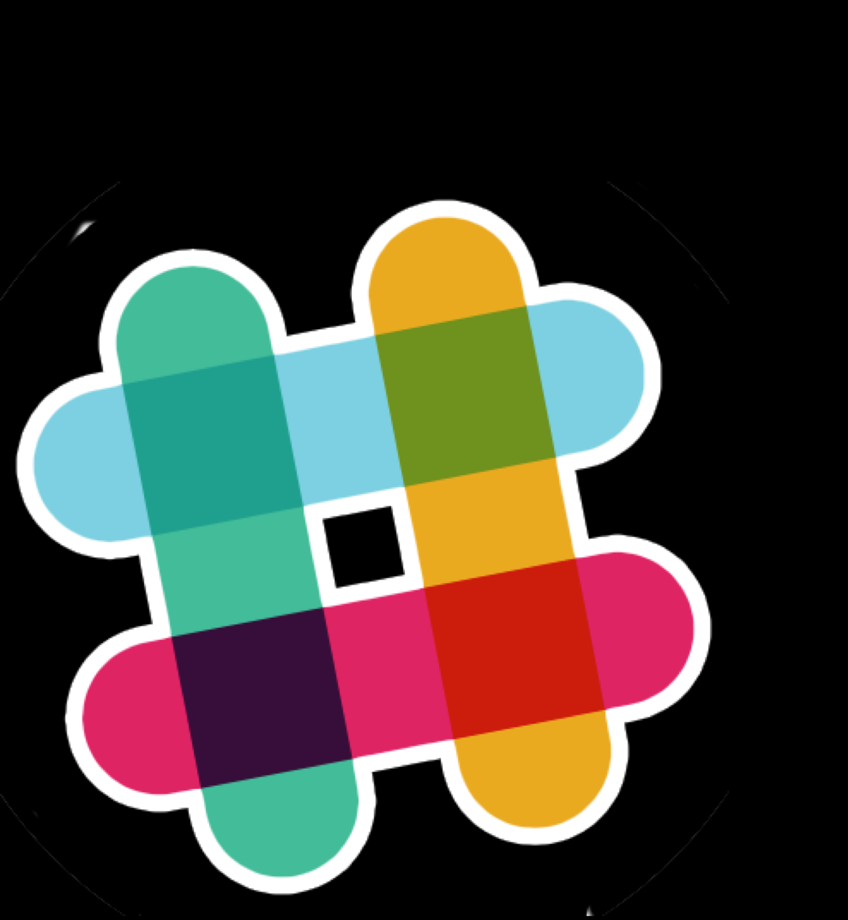






Conversational AI: Azure Bot Service + Cognitive Services
User Input
Channels
Bot Intelligence
Business Process
Start
LOB Apps
Bing Search
Transition 1
Transition 2
Text
State 1
State 2
Transition 3
Speech
Transition 4
State 3
Bot Framework
On premise
Speech
IFTTT
Enterprise stores
QnA Maker
Dispatch
Image
Translator
Language understanding
Notes:
r

Slide 5




Bot Framework
Platform
Platform
Services
AI
Cognitive
Services
HTTP
LUIS
SDK
REST Endpoint
Dispatch
Bing
Search
QnA
Maker
REST endpoint
Direct Line Protocol
Conversational and business logic
Canvas aware
Context sensitive
Notes:
m

Slide 6
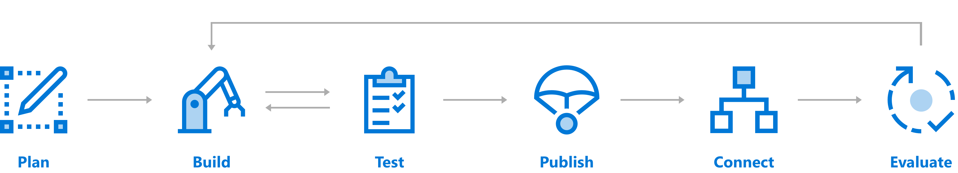




Create a Conversation with Bot Service
Comprehensive framework for the lifecycle of your project
Author Dialogs
Design Cards
Visualize
Bot Framework SDK
Cognitive Services
Getting Started Templates
Emulator​
Application Insights
DevOps Tools
Azure
BYO Web Host
WebChat
Cortana
Skype, FB
+
Custom (DirectLine)
Application Insights
LUIS Suggestions
Notes:
m

Slide 7
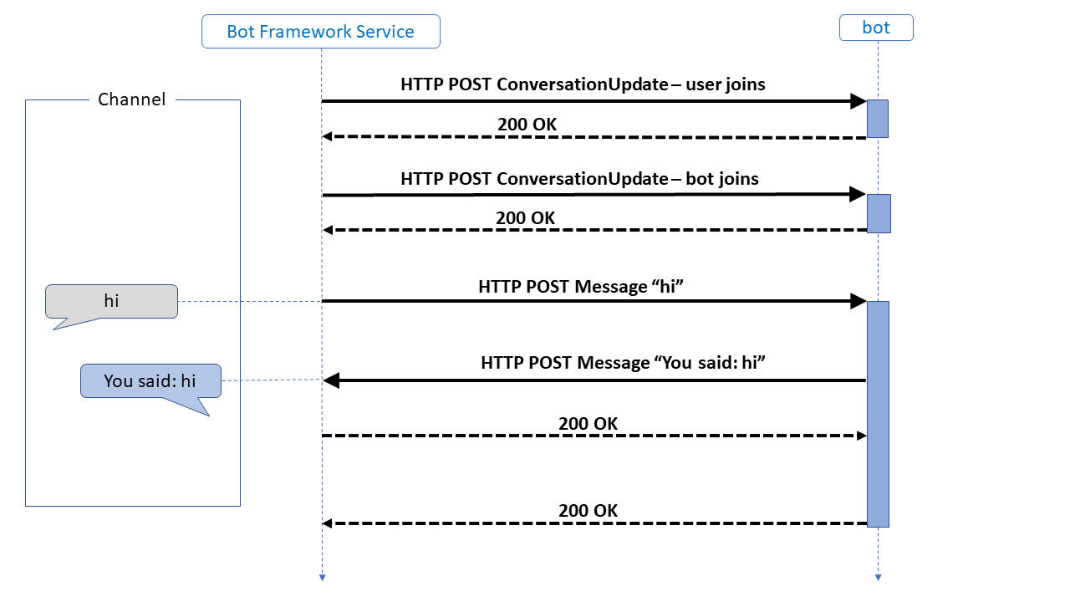
Intro on how the bot framework works
Basic conversation flow
Every interaction creates an activity
Bot Framework interacts with the user via channel
ConversationalUpdate and Message
Requests arrive to the bot via HTTP POST
Status responses are an HTTP 200
Conversation in managed via TurnContext
Notes:
https://docs.microsoft.com/en-us/azure/bot-service/bot-builder-basics?view=azure-bot-service-4.0&tabs=csharp
m

Slide 8
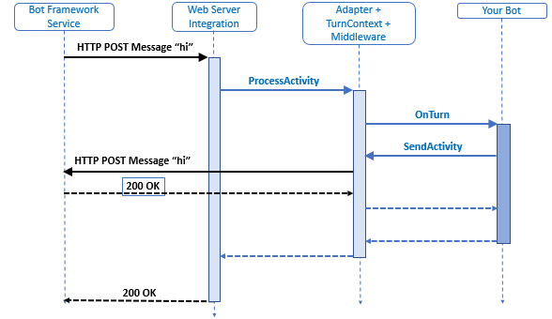
Intro on how the bot framework works
Activity generated by “hi”
Activity is executed via JSON
JSON is deserialized and sent to the Adapter, using the ProcessActivity method
Adapter creates the TurnContext and calls the middleware
Activities are managed by the ActivityHandler
Notes:
m

Slide 9
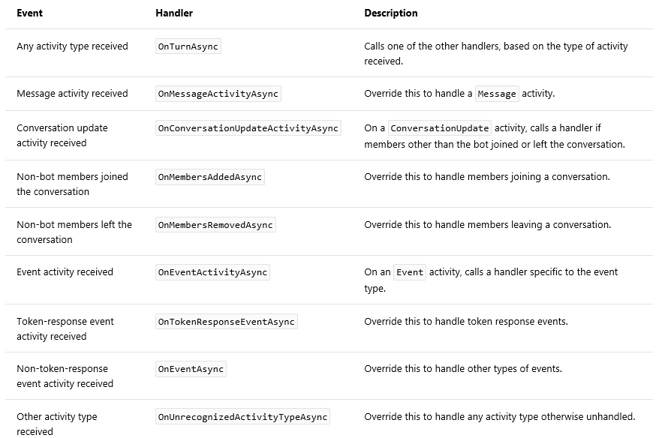
Activities
Main logic resides on the BotEcho file
Inherits from the ActivityHandler
Methods for activities are protected, but can be overwritten
Notes:
https://docs.microsoft.com/en-us/azure/bot-service/bot-builder-basics?view=azure-bot-service-4.0&tabs=csharp
m

Slide 10
DEMO Create the first bot using Visual Studio
Notes:
r

Slide 11
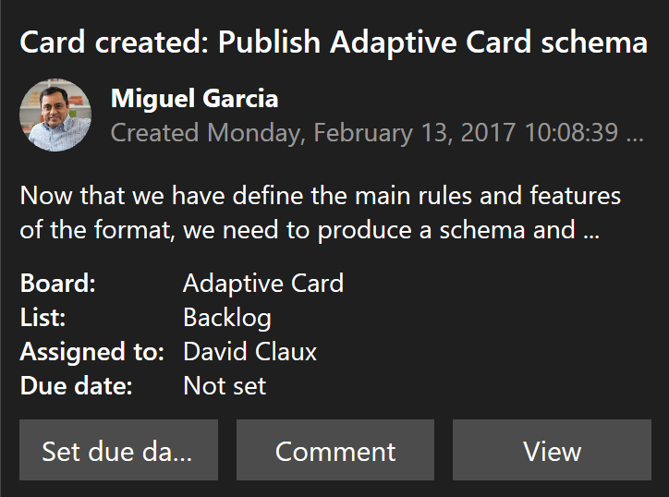
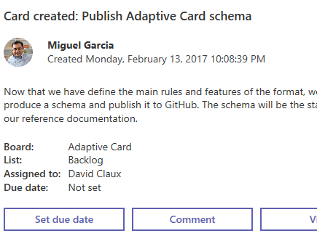
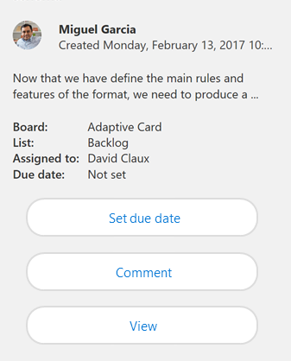
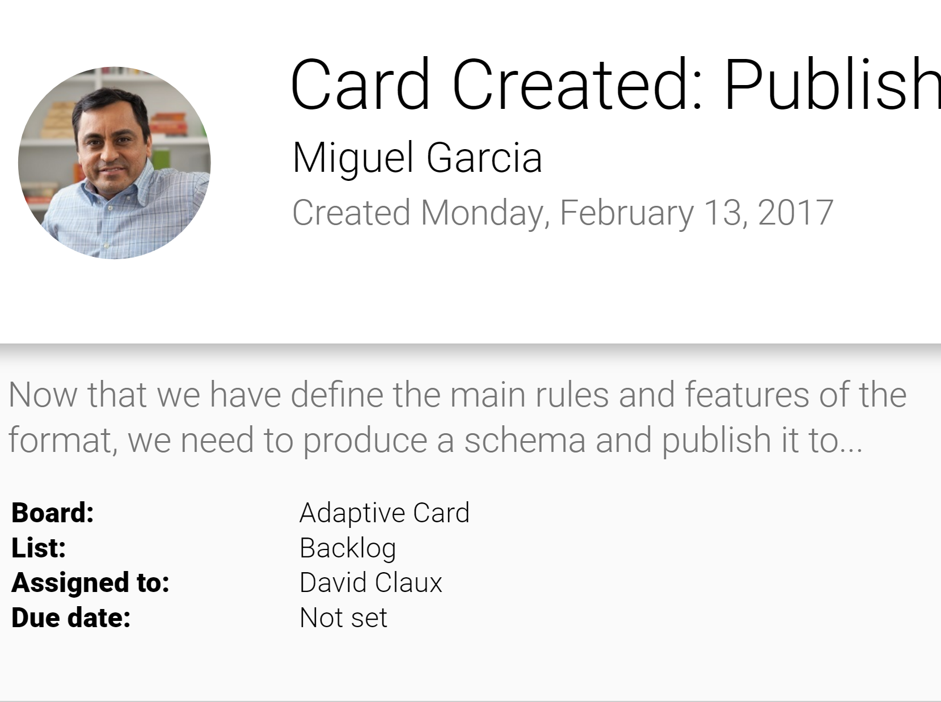
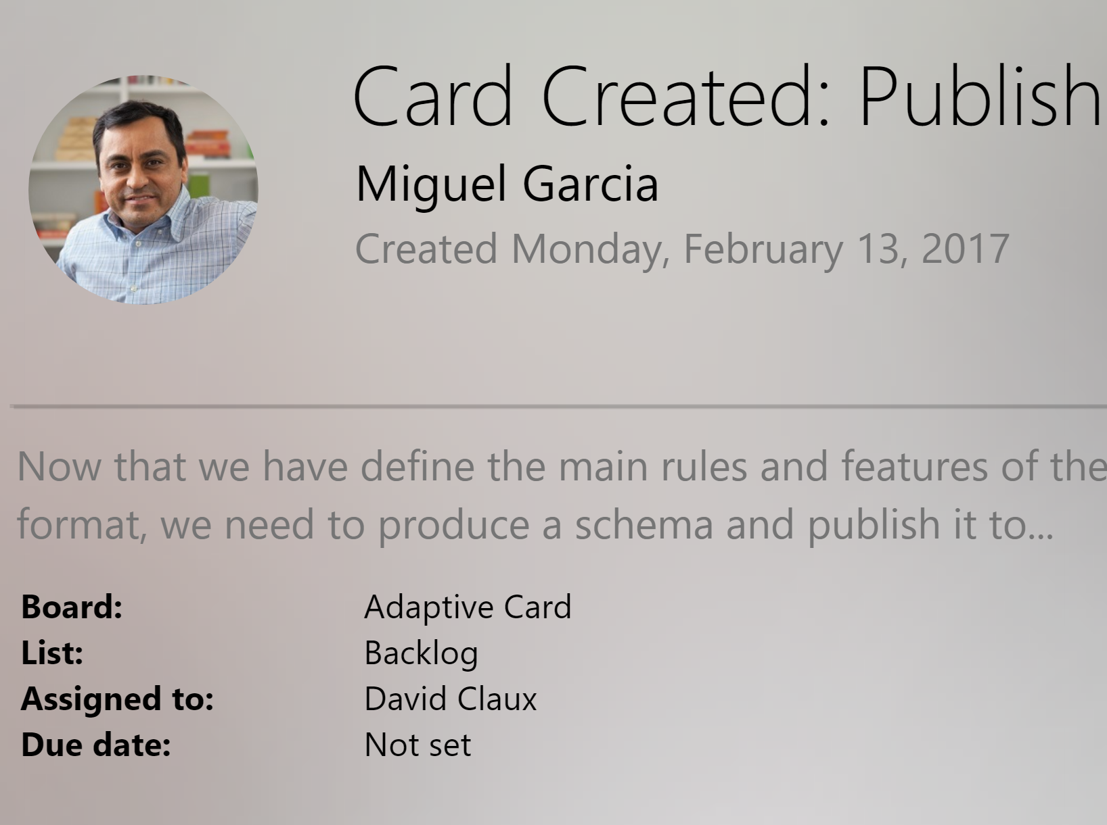
Adaptive Cards
Open Framework Multiple Canvases
Notification
Microsoft Teams
Skype
Android
iOS
Bot Service Lifecycle: Plan | Build | Test | Publish | Connect | Evaluate
Notes:
m

Slide 12
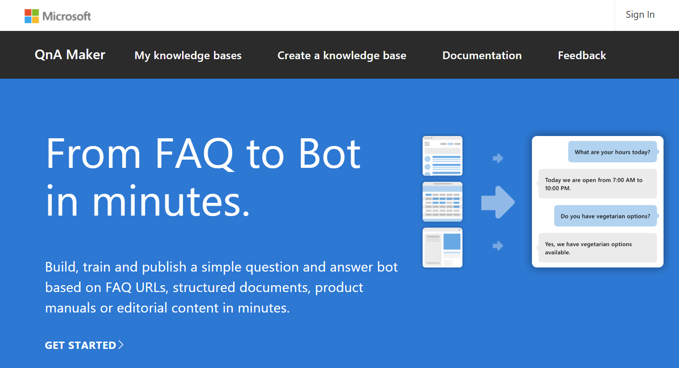
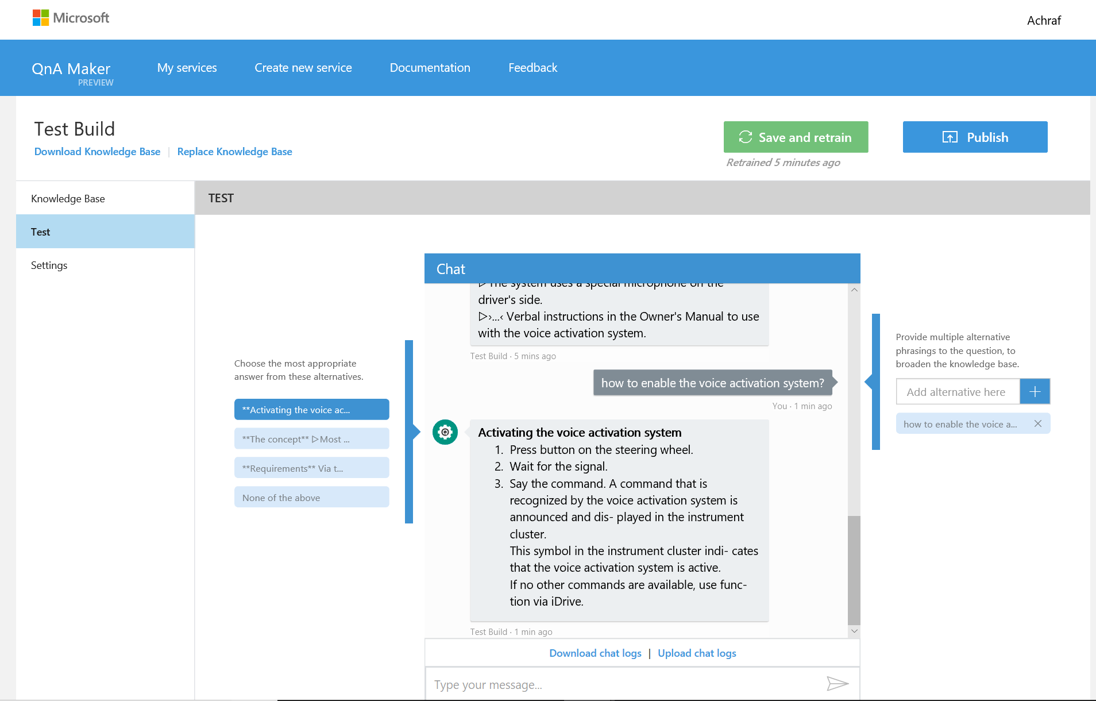
QnA Maker
Based on Azure. The data and runtime hosted in your Azure subscription.
Data privacy and compliance. QnA data is hosted within your Azure compliance boundary.
Azure Application Insights integration. Helpful to get insights on how the services is being utilized.
Notes:
m

Slide 13

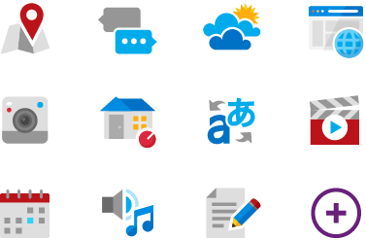
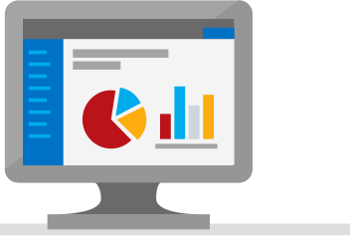
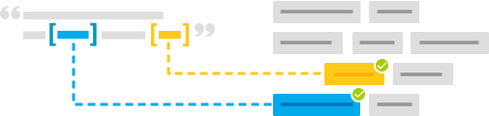
Language Understanding (LUIS)
Machine learning-based service to build natural language into apps, bots, and IoT devices. Quickly create enterprise-ready, custom models that continuously improve.
Add natural language to your apps
Quickly build a custom language solution
Always learning & improving
Enterprise-ready, available worldwide
Bot Service Lifecycle: Plan | Build | Test | Publish | Connect | Evaluate
Notes:
m

Slide 14
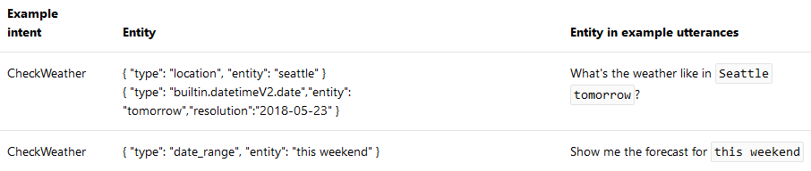
LUIS – terminology
Intent – the action/task the user wants to perform
Utterance – the sentence where the user expresses the goal
Entity – words or phrases inside an entity
Domain –Intents related to a specific type of actions (e.g. Calendar intents) – prebuilt domains
Notes:
m

Slide 15


Dispatcher
Find conflicts & overlap
BOT COMPONENTS
Language Model
Evaluate & Improve
LUIS
Dispatch Model
QnA
Custom Model
BOT COMPONENTS
Dispatcher
LUIS
Utterance
Dispatch
Bot Logic
ANSWER,
INTENT
QnA
OTHER
Response
BOT RUNTIME
Notes:
How to dispatch information to different services : https://docs.microsoft.com/en-us/azure/bot-service/bot-builder-tutorial-dispatch?view=azure-bot-service-4.0&tabs=cs
m

Slide 16
DEMO QnAMaker; LUIS
Notes:
m

Slide 17
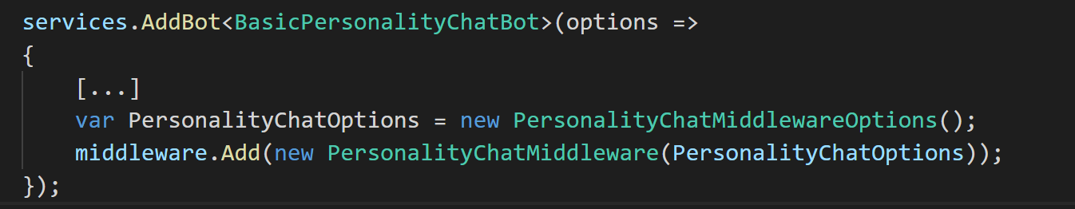
Adding Personality Chat
Notes:
r

Slide 18
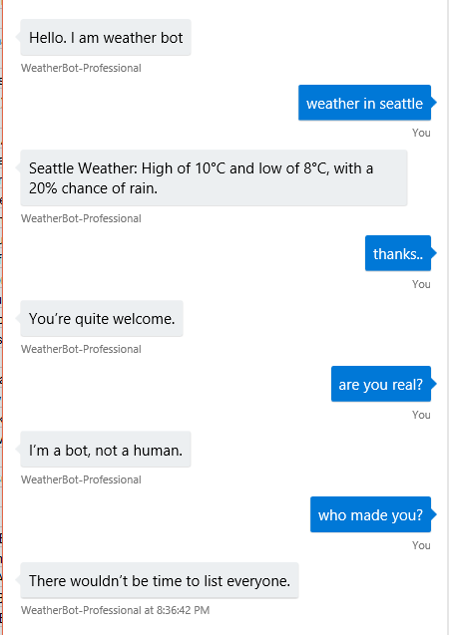
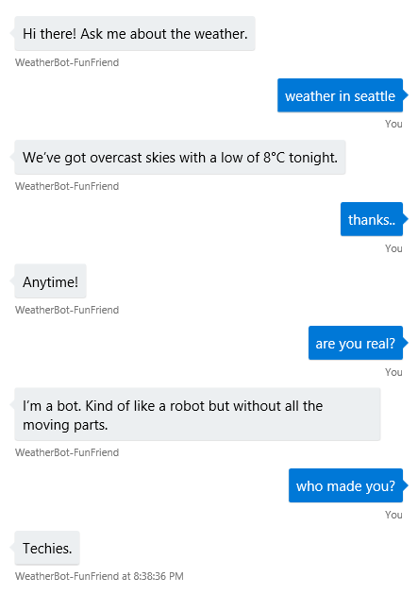
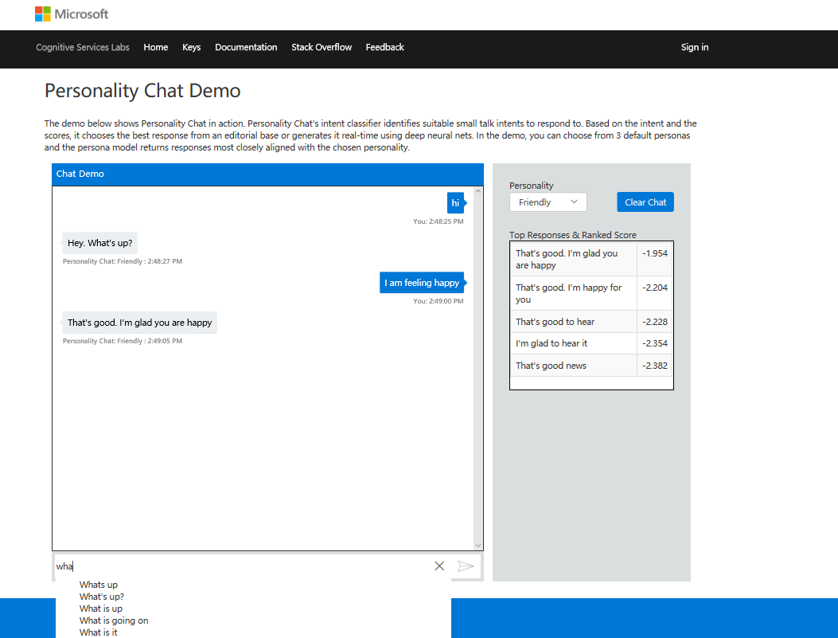
Bot Personality
Professional
Friendly
https://www.microsoft.com/en-us/research/project/personality-chat/
Notes:
r

Slide 19

Adding Intelligence
Language Understanding Intelligent Service
Azure Search
QnA Maker
Teach your apps to understand commands from your users
Integrate search into a conversational experience
Distill information into conversational, easy-to-navigate answers
Bing Speech API
Speaker Recognition API
Translator
Custom Speech Service
Convert speech to text and back again, and understand its intent
Give your app the ability to know who's talking
Easily perform speech and text translation
Fine-tune speech recognition for anyone, anywhere
Notes:
r

Slide 20
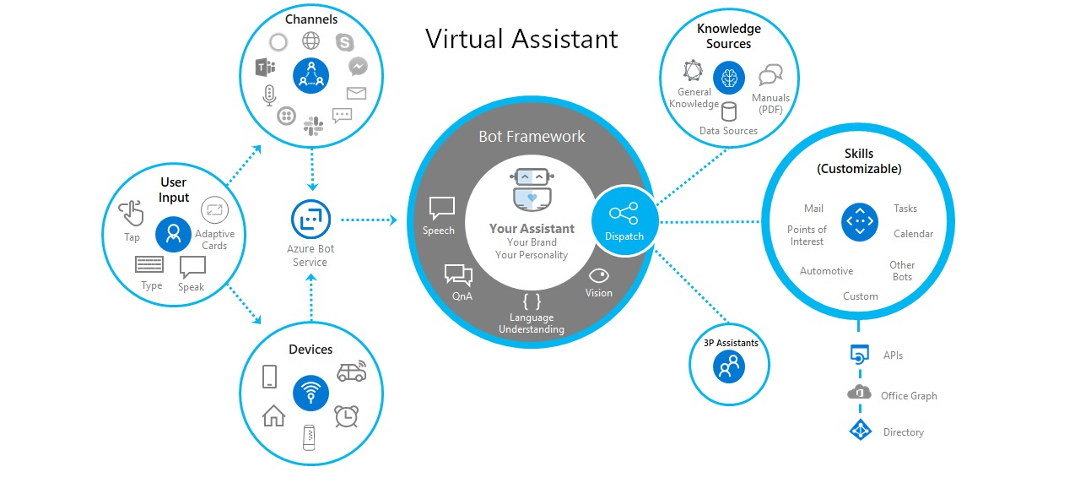
Example of Bot Framework implementation
Notes:
How to build a virtual assistant : https://docs.microsoft.com/en-us/azure/bot-service/bot-builder-virtual-assistant-introduction?view=azure-bot-service-4.0
r

Slide 21
DEMO Sarah
Notes:
m

Slide 23

GRAZIE!
Riccardo Cappello
Marco Parenzan
Senior ICS Consultant @ Insight
Microsoft Azure MVP
Intel Software Innovator
Senior Sales Specialist @ Insight
Microsoft Azure MVP

